Slide 1

Title: An Explainable Password Strength Meter Addon via Textual Pattern Recognition
Presentation
North Western University , Khulna.

Slide 2
Course Code: CSE-4302
Course Title : Computer Graphics and Pattern Recognition Sessional.
Submitted By
Submitted To
1. Name: Chandan Sourav Mallick ID:2020106510
2. Name: Saifur Rahman ID:20201165010
3. Name: Sajib Bhattacharjee ID:2020107010
Department of Computer Science and Engineering
Name: M. Raihan
Assistant Professor
Department of Computer Science and Engineering
Department of Computer Science and Engineering
North Western University , Khulna.

Slide 3
Abstract
Addon enhances PSMs for textual password vulnerabilities, offering detailed pattern feedback to improve user comprehension. Study on Alexa's top 100 sites reveals a lack of such platforms. Identifies twelve weak password patterns from 70 million leaked passwords. Evaluation confirms effectiveness in aiding users for more secure passwords.
North Western University , Khulna.

Slide 4
1. Introduction
This paper delves into Internet password vulnerabilities, focusing on users' inclination toward weak and reused passwords. It underscores limitations in current password policies and strength meters. The introduced PSM addon offers detailed feedback on weaknesses, spotlighting common patterns using data from 70 million leaked passwords. The study assesses the addon's efficacy in addressing PSM issues and improving user security awareness. Key contributions include the addon introduction, PSM survey insights, and positive user study results, concluding with future work considerations.
North Western University , Khulna.

Slide 5
2. Related Work
Previous studies focused on password strength meters (PSMs), often using simplistic methods that lead to inaccuracies. Traditional models, like NIST's entropy-based approach, struggle with evaluating user-chosen passwords.
Research explores alternatives like password cracking and behavior modeling. Solutions like zxcvbn and Ur et al.'s meter reduce weak password patterns but lack detailed explanations. Our novel PSM addon emphasizes pattern passwords for enhanced user understanding and potential behavior improvement. It detects regional patterns, phone numbers, and date variants, providing comprehensive feedback. Tailored for Chinese users, it suggests client-side deployment to boost awareness of weak passwords.
North Western University , Khulna.

Slide 6
3. Explainable Password Strength Meter Addon
Enhancing password security through email pattern matching and addressing vulnerabilities in pure letter and digit patterns. Utilizing regular expressions and a Two-Pattern Combination Matching Algorithm for Pinyin+Date, Pinyin+Phone, wire phone numbers, and pure letter+digit. Exclusion of three-pattern combinations reduces user burden. Leaked password analysis from sites like CSDN, Tianya, Duduniu, 7k7k, and 178.com offers insights into password patterns and security.
North Western University , Khulna.

Slide 7
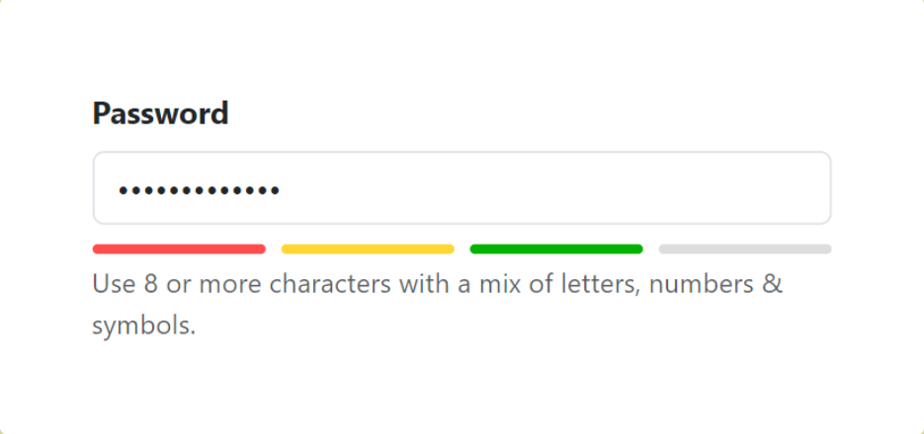
North Western University , Khulna.

Slide 8
4. Evaluation
Evaluation reveals PSM shortcomings on top Alexa websites, with only three offering guidance and causing user confusion. A study exposes deficiencies in some sites, jeopardizing access control. The leaked password analysis emphasizes pattern matching's importance, showcasing the addon's superior detection, including Pinyin patterns. The dataset of 70 million passwords highlights prevalent patterns like pure digits and Pinyin+date. In conclusion, the evaluation stresses the need for user-friendly PSMs, praising the addon's broader pattern detection, crucial for enhancing password security, especially for Chinese users.
North Western University , Khulna.

Slide 9
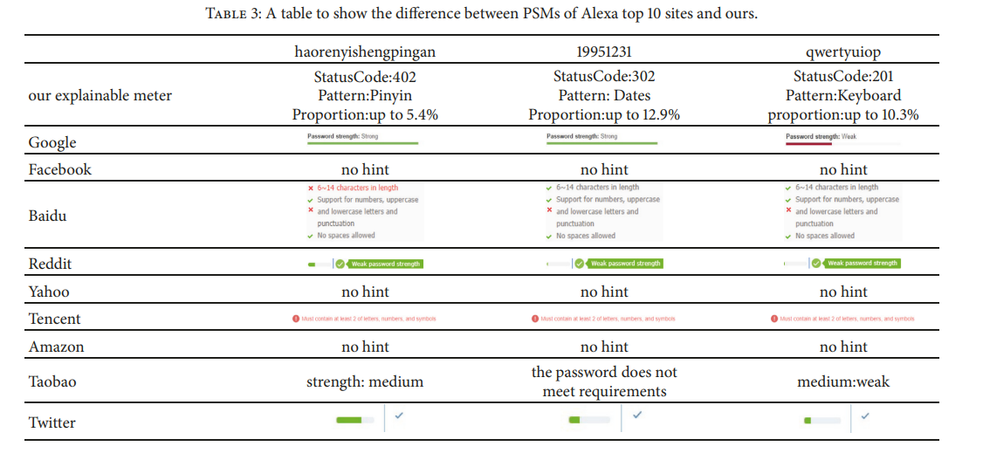
North Western University , Khulna.

Slide 10
5. User Study
The user study with 50 college students found that the explainable PSM addon effectively influenced password habits, emphasizing common use of digit+letter combinations. Participants were willing to change behaviors based on addon warnings, showcasing improved security awareness. Other identified pattern passwords indicated a potential shift toward more secure practices. In summary, the study demonstrated the addon's impact on fostering awareness and encouraging safer password practices.
North Western University , Khulna.

Slide 11
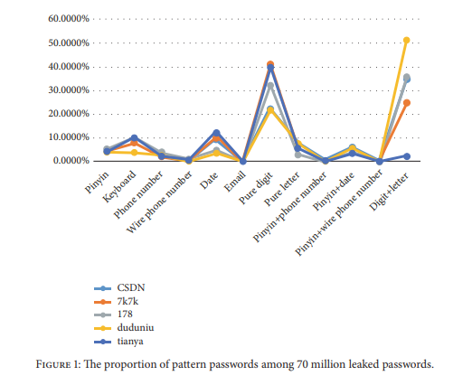
North Western University , Khulna.

Slide 12
6.Conclusion
In summary, our study highlights PSMs' role in encouraging users to adopt stronger passwords. The user study affirms the effectiveness of our addon in enhancing usability. Despite only three top Alexa websites providing limited pattern information, our integrated addon outperforms in detecting more patterns, especially keyboard patterns in leaked passwords.
North Western University , Khulna.

Slide 13
Thank you
North Western University , Khulna.

